Slide 1


22-1-2-2599
P4 Traffic Classification
Guy Davidi & Amit Davidi
Company: MARVELL

Slide 2
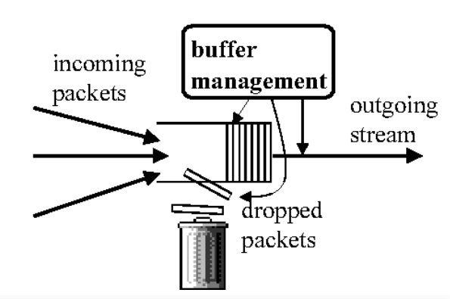
22-1-2-2599
Abstract
The Problem we want to solve:
When too many packets arrive at the switch faster than they can be processed and forwarded, a buffer overflow occurs, which leads to loss of packets, and reduced quality of service.
Goal:
On a Switch, run a packet management algorithm that will classify packets and maximize the data throughput in case of buffer overflow thus increasing QOS.

Slide 3
22-1-2-2599
Quantitative metrics
A software switch that runs an algorithm that classifies packets and implement a buffer management procedure that maximizes the data throughput and
can be tested with a traffic generator.
A software switch that can be configured to run any sort of algorithm based on p4 code.

Slide 4
22-1-2-2599
How are we going to achieve our goals?
Problem: Having a Configurable Software switch
Solution: DPDK (overview next slide)
Problem: Configuring the Switch (pipeline) to implement Different algorithms.
Solution: P4 & p4c (overview next slide)
Problem: Validation
Solution: Packet generator – generate and pass packets into the
Switch, log the throughput of our algorithms.

Slide 5
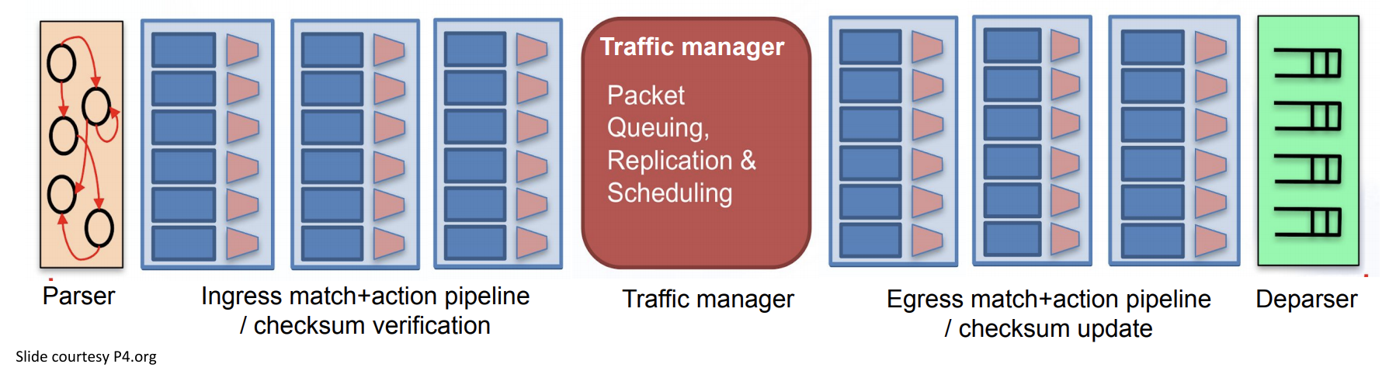
22-1-2-2599
What is a switch?
Switch’s Pipeline:

Slide 6
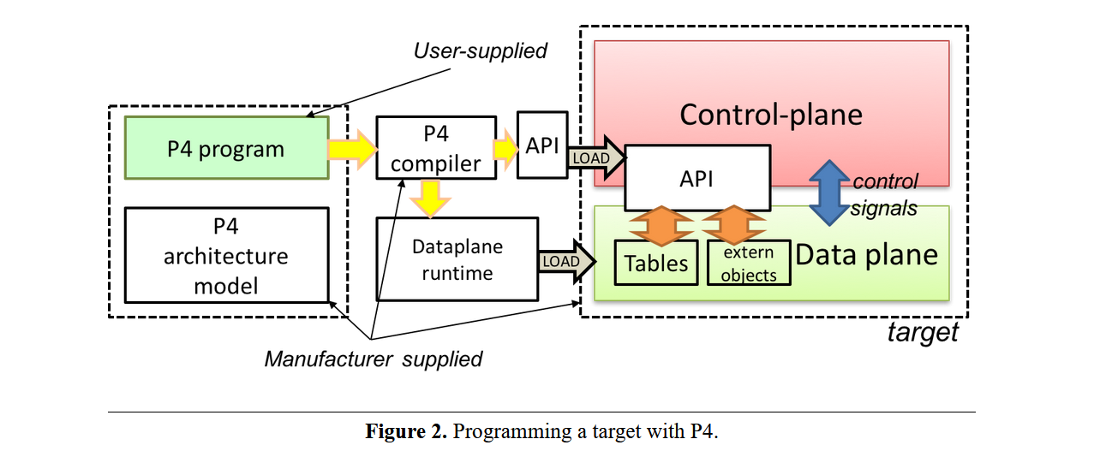
22-1-2-2599
P4, P4 Compiler
P4 is a language for expressing how packets are processed by the data plane of a programmable forwarding element such as a hardware or software switch.

Slide 7
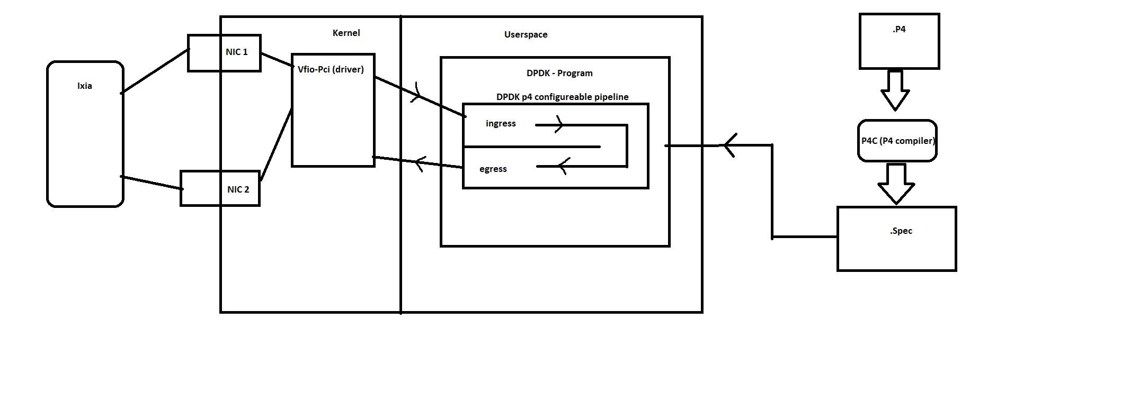
22-1-2-2599
Our topology:
https://github.com/DavidisP4/p4_project
Steps
1. Write a .P4 program that expresses how packets are processed (pipeline)
2. Compile .P4 to .spec using P4C.
3. Configure DPDK software switch Pipeline
Using the .spec
4. Pass packets into the pipeline Using our Packet generator.
5. View and log packet statistics (Throughput, …)

Slide 8
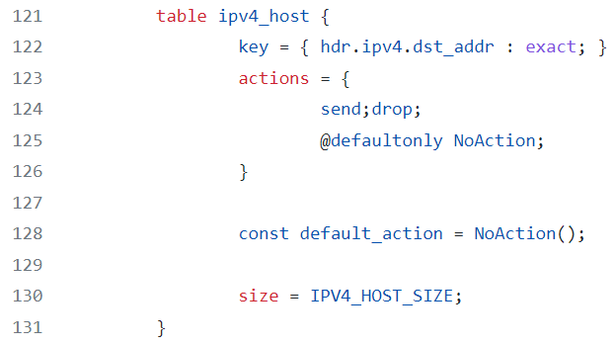
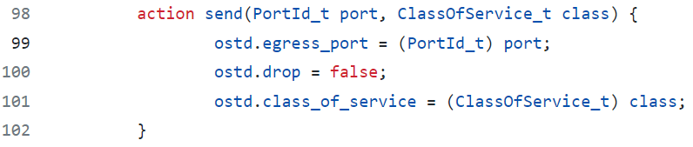
22-1-2-2599
How to configure the pipeline using P4 ?
Match Action, Packet processing
Match action tables can be easily defined in P4:
An example for a table:
Example for actions:

Slide 9
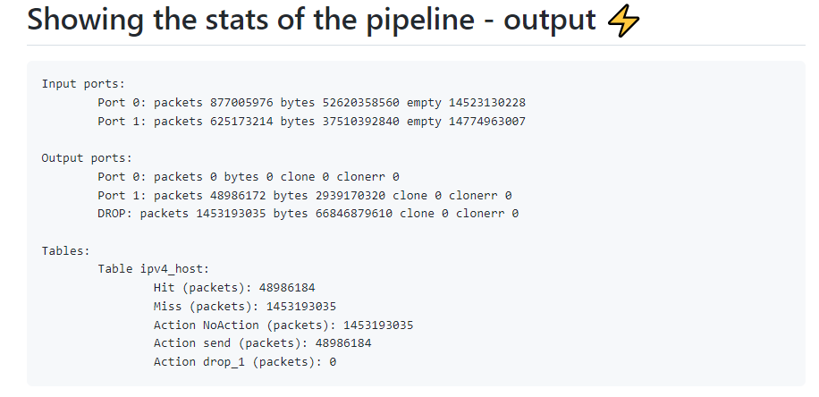
22-1-2-2599

Slide 10
22-1-2-2599
goal | expalnation | deadline | status
submmiting a work plan |  | 21.11.22 | done
introduction to DPDK packet processing study | getting familiar with DPDK | 30.11.22 | done
Completion of Basic computer communication concepts \ topics | self study of communitcation protocols \ operating systems | 1.12.22 | done
Build development setup | bring up setup with 2 Nics, Ixia(traffic generator), server to work on | 30.12.22 | done
Integraion of DPDK and our setup | Setting up and installing P4C, DPDK, connecting NICS to DPDK, and to the traffic generator. Finding a way of implementing a software switch. (DPDK | p4runtime | OVS | p4-dpdk-target | dpdk-pipeline ) | 15.1.23 | done
Getting familiar with p4 | in this part we Implemented : an L2 forward and L3 forwarding applications in P4. and tested them with our packet generator | 5.2.23 | done
Implementation of traffic classification algorithm | finding a way of configuring the match-action tables of the software switch. | 5.2.23 | done
Implementing basic buffer-overflow management algorithms | Based on Proff. Pat shamirr research papers, Implmementing L3 fw algorithm, Add define match action table with P4 run time load math action table with DPDK API's, assign QoS to each packet based on it's destintion IP. | 1.4.23 | In progress
Implementing final buffer-overflow management algorithm | testing and re-iterations, untill we obtain our final results | 1.5.23 | In progress

